Slide 1

Task 4 Domain Model and Sequence Diagram
Team Blue
Lars Gertsch | Simon Herrmann | Steve Blaser | Fabio Caggiano | Silas Stulz | Sinthujah Kaneshan

Slide 2
Contents
1. UML domain model
2. UML sequence diagram: user updates
3. UML sequence diagram: system alerts

Slide 3
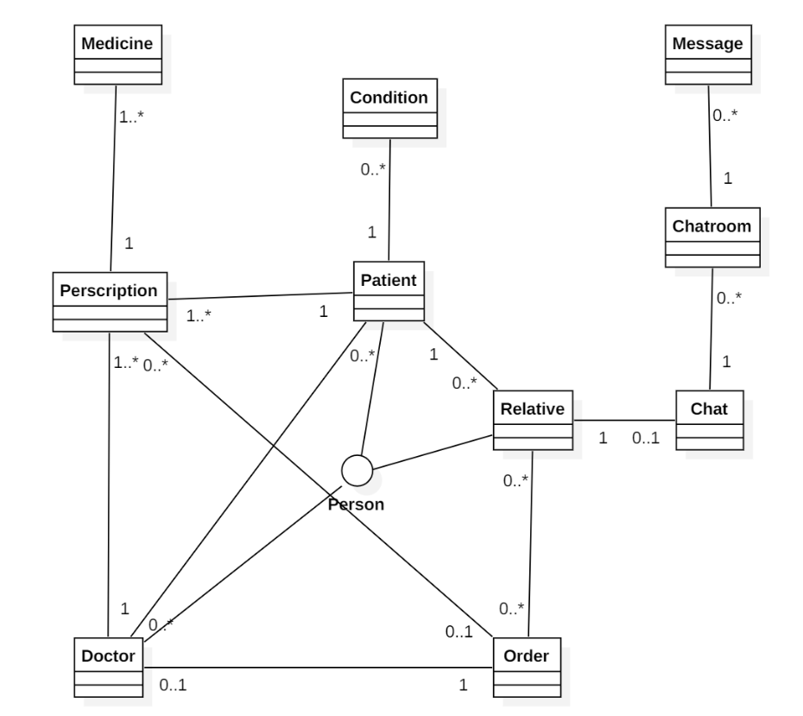
UML domain model

Slide 4
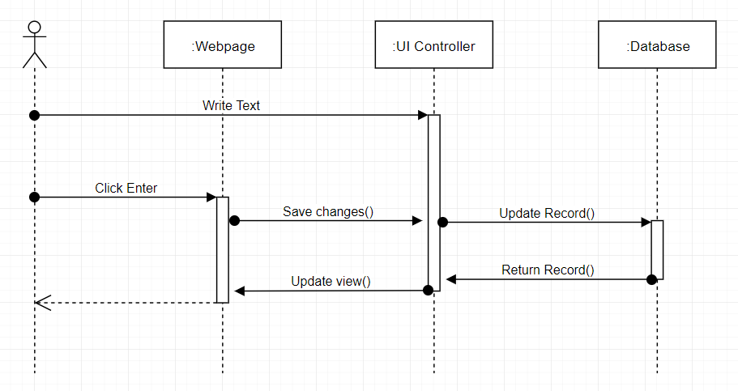
UML sequence diagram: user updates
Team Blue
4

Slide 5
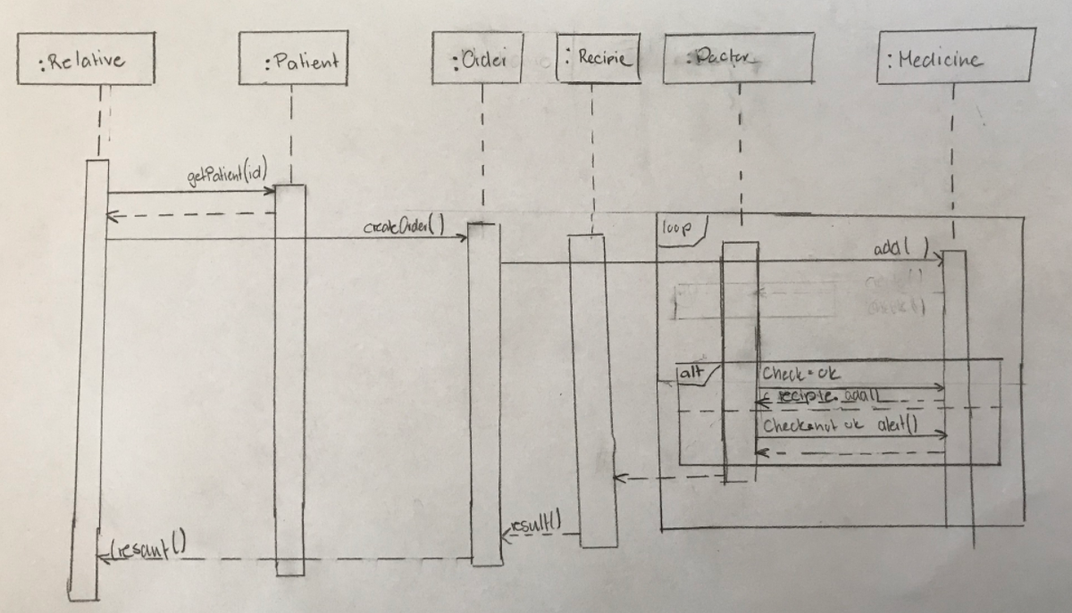
UML sequence diagram: system alerts

Slide 6


